Slide 1
Presents
OO Programming with Java
Collections
Notes:
Collections
Module 14

Slide 2
Learning Objectives
In this module we will:
Examine the Collections Framework

Slide 3
Collections: Introduction
Collections offer alternatives to arrays that are more flexible and more powerful.
  One of the main limitations of an array is that its length is fixed when it is created.
  Collections will grow to hold more elements automatically.
Collections rely heavily on generics and interfaces to provide common behavior.
There are three major types of Collections: Sets, Lists and Maps. Each is intended for a different kind of Collection.

Slide 4
More on Collections
A Collection can hold any Java object.
  Collections can NOT hold primitives or arrays. However, primitives can be passed to Collections of Wrapper classes. They will be retrieved as instances of the wrapper, but autoboxing still hides that detail, for the most part.
With the use of generics we can specify what type of objects are being put into the collection.
  Type safety is assured by the compiler when objects are retrieved from the collection.
  If not for Generics, Java would upcast everything to Object, forcing us to filter out undesired types, and downcast desired objects to their original types.
  Instead, we are able to specify the specific type with we want to work.

Slide 5
A Simple Example
Before we delve into the details of Collections, we will look at an example to help us see what’s going on.
  We’ll use the ArrayList class, which stores objects in much the same way an array does.
  In an ArrayList, each entry is indexed by an int.
  We can add elements by specifying a numeric position. If we don’t specify a position, Java just uses the next available number.
  Use generics to specify what type of object is being placed in the ArrayList (improves type safety).
  We’ll pass the ArrayList to a method that will work with the objects, and we’ll set their speeds to 55.

Slide 6
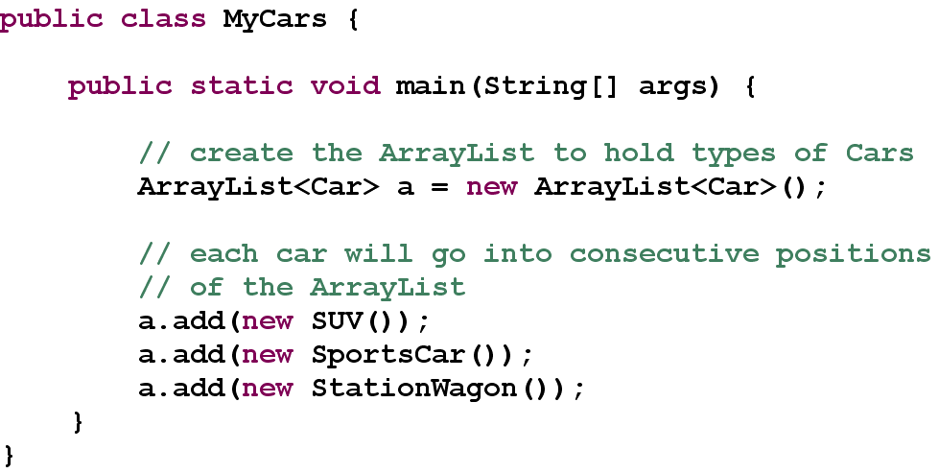
Example Code
Notes:
Note that the package statement and imports were omitted to save space.

Slide 7
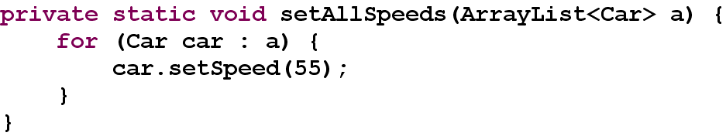
Code Example Continued
We pass the ArrayList to the setAllSpeeds() method.
Notice the use a for-each style loop to access the objects in the ArrayList – easier than using a regular for loop.
  Even easier in Java 8.
    Java 8 added a default forEach method to the Iterable interface. We will discuss this at the end of this unit.
    Example: a.forEach(car->setSpeed(55));
The use of generics guarantees all objects in the list to be of type Car.

Slide 8
Code Example Summary
The ArrayList works much the same way as an array of Cars would have, except that we use methods instead of square brackets.
The ArrayList is more flexible than an array because we do not have to consider the maximum number of items we’ll want to store in it. The ArrayList manages its own internal storage transparently to us.
Now we’ll move on to the Collection interfaces.
  Speaking of interfaces, there is a poor practice exhibited in the code. The only place where the ArrayList class should have been used is with new ArrayList. Every other use should have been List<Car>. The practice is left here so that we can point it out, as you will often encounter this practice in live code.
  Declare references with the most abstract interface you can.
Notes:
The improper use of ArrayList as the reference type is left in the sample code as a talking point to remind you what not to do. You will encounter a lot of poor code in the real-world, and it helps to recognize it when you’ve seen it.

Slide 9
The Collection Framework
The Collections interfaces are all stored in the java.util package
«interface»
Collection
«interface»
Map
«interface»
Set
«interface»
List
«interface»
SortedMap
These classes and interfaces are not Collections but are often used when working with Collections
«interface»
SortedSet
«interface»
Comparator
«interface»
Iterator
Notes:
Although Map does not inherit from Collection, it is still considered a Collection because a Map holds a group of other objects.

Slide 10
The Collection Interface
Here is a list of the classes that implement Collection:
  AbstractCollection
  AbstractList
  AbstractSet
  ArrayList
  HashSet
  LinkedHashSet
  LinkedList
  TreeSet
  Vector
All of the classes in italics are abstract
In the following slides we will examine some representative examples of these classes
Here are the sub-interfaces:
  BeanContext
  BeanContextServices
  List
  Set
  SortedSet

Slide 11
Important Methods of the Collection Interface
public interface Collection<E> {
// Basic Operations
int size();
boolean isEmpty();
boolean contains(Object o);
boolean add(E e);
boolean remove(Object o);
Iterator<E> iterator();
// Bulk Operations
boolean containsAll(Collection<?> c);
boolean addAll(Collection<? Extends E> c);
boolean removeAll(Collection<?> c);
boolean retainAll(Collection<?> c);
void clear();
// Array Operations
Object[] toArray();
Object[] toArray(T[] a);
Every class that implements Collection<E> directly or indirectly, must implement these methods
  This list is not complete
  Also not shown is that Collection<E> extends Iterable<E>
Take a moment to examine the shared capabilities of all Collection based objects
Notes:
Remember that since the Map classes do not inherit from Collection, they do not share these methods.

Slide 12
The Set Collections
A Set is a Collection which contains no duplicate elements
When extracting elements from a Set via a loop, there is no guarantee that you will receive them in the same order you added them to the Set
The implementing concrete classes of Set are: HashSet, LinkedHashSet, and TreeSet
The sub-interface SortedSet, which is implemented by TreeSet provides a way to create sets that are sorted

Slide 13
When to Use a Set
Obviously you can only use a Set when the order of your elements is unimportant
It is preferable to use Sets in these situations because they are faster than Collections that include ordering

Slide 14
Example: The HashSet
The HashSet allows you to store objects, but does not provide any methods for ordering them.
The HashSet uses the Iterator interface, which we will discuss before continuing the example.
HashSet<Car> h = new HashSet<Car>();
h.add(new SUV());
h.add(new SportsCar());
System.out.println(h.size());

Slide 15
The Iterator Interface
The Iterator interface provides simple methods for accessing the elements of a container from first to last.
Its two most important methods are:
  next()
  hasNext()
next()retrieves the next element in the container
hasNext()returns true or false based on whether or not there is another element in the container

Slide 16
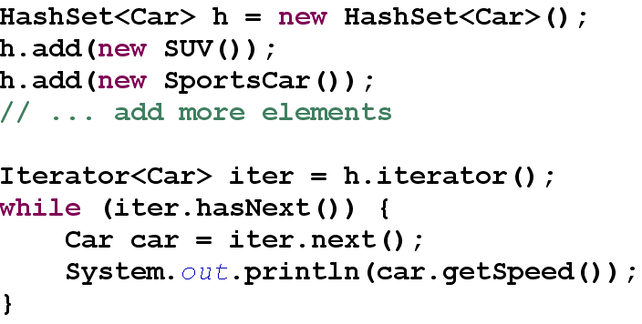
Example: Iterator and HashSet
iterator() is used to obtain a iterator of the elements.
The explicit use of an iterator, such as shown here, is usually an anachronism in modern Java.
Modern Java uses either the enhanced for loop or the Java 8 forEach method.
Notes:
The code here will print out the speed of each car in the HashSet. We will not know what order we’ll get the speeds in though!

Slide 17
A Potential Problem with Iterator
What happens if the contents of a Collection changes after you have extracted an Iterator?
Clearly, there will be problems if your Iterator no longer reflects the contents of the Collection.
In this situation, Java creates a run-time error condition called an Exception. Exceptions will be covered in a later chapter.

Slide 18
Sorted Sets
The core API includes one implementation of SortedSet, the TreeSet.
Sorting can be specified by an instance of the Comparator class, which TreeSet uses or by relying on TreeSet’s built in implementation of the Comparable interface.
Our example on the next slide will sort Strings alphabetically using the built in sort facility.
Notes:
Comparable sorts by the “natural order” of the elements in the set. The details of this “natural order’ are complicated. Details can be found in the API.

Slide 19
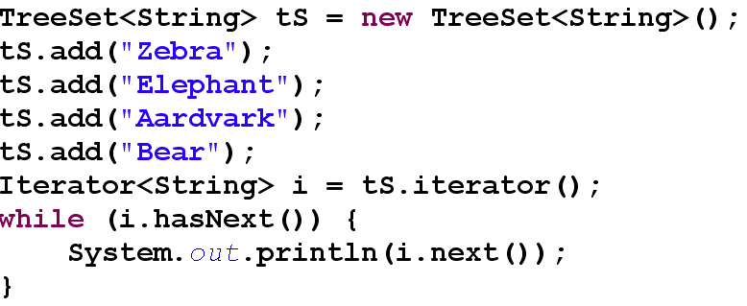
Example: TreeSet
In this example the Strings will be sorted alphabetically by the TreeSet’s internal Comparator.
The output will be: Aardvark
Bear
Elephant
Zebra

Slide 20
The List Collections
A List is a collection in which the elements have been placed in a specific order.
List classes allow the user to specify the exact position of any element in the list.
The implementing classes of List are LinkedList, ArrayList, Vector and Stack.
Notes:
The ordering performed by the List class is not the same as the sorting done by the TreeSet class.
With a list, the user can control where in the sequence a particular item occurs and NO re-ordering is performed as items are added and removed.

Slide 21
Important Methods of the List Interface
public interface List<E> extends Collection {
E get(int index);
E set(int index, E element);
void add(int index, E element);
boolean remove(Object o);
boolean addAll(int index, Collection<? extends E> c);
// indexes specific elements
int indexOf(Object o);
int lastIndexOf(Object o);
// provides listiterator references
ListIterator<E> listIterator();
ListIterator<E> listIterator(int index);
// gets a sublist from the current list
List subList(int fromIndex, int toIndex);
}

Slide 22
The Map Collections
The Map collections use key value pairs as their elements.
Values can be duplicated; keys can not.
The implementing classes of Map are HashMap, LinkedHashMap, PrinterStateReasons, IdentityHashMap, TreeMap and WeakHashMap.

Slide 23
Important Methods of the Map Interface
public interface Map {
Object put(Object key, Object value);
Object get(Object key);
Object remove(Object key);
boolean containsKey(Object key);
boolean containsValue(Object value);
int size();
boolean isEmpty();
// Bulk Operations
void putAll(Map t);
void clear();
public Set keySet();
public Collection values();
public Set entrySet();
}
Notes:
Note: A Map does NOT extend Collection . They are just too different, even at the Interface level.

Slide 24
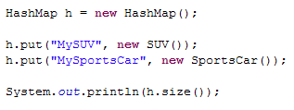
Example: The HashMap
Because we have key/value pairs, we use put instead of add to place new elements in the Map:
But notice how the map was declared …

Slide 25
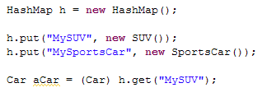
Example: The HashMap
The key and value were both upcast to Object. When we extract them we must downcast them properly.
We can extract individual items with the get method. This method accepts a key and returns its value.
It would have been better if the author had used Map<String, Car> = new HashMap<>(), instead.

Slide 26
Iterating over a Map
We have many ways to iterate over a Map.
  Call the keySet() method, and iterate over the set of keys
  Call the values() method, and iterate over the collection
  Call the entrySet() method, and iterate over the set of entries
    Map.Entry contains a [key, value]-pair, with getKey() and getValue() methods.
  Java 8: use the new Map.forEach() method, and iterate over the entries, that way.
    The parameter to Map<K,V>.forEach() is BiConsumer<K,V> which is a functional interface whose required method takes two parameters: the key and the value.
    For example:
    m.forEach((k,v)->System.out.printf(“%s -> %s”, k, v));
    We will discuss forEach and Consumer interfaces shortly.
Notes:
Note: This example uses the older Java 1.4 technique of accessing a container. Notice how the objects must be cast to the correct type (Car) as they are retrieved from the Iterator. It is also possible to put non-Car objects into a container of this type because the compiler is not guaranteeing type safety.

Slide 27
Linked Collections
Linked Collections should be used when you wish to be able to iterate over their contents in a defined order, e.g., the order in which elements were added.
In addition to LinkedList and LinkedHashSet, there is also LinkedHashMap.
The behavior of LinkedList was discussed earlier, and should come as no surprise, but the other two do something special:
  They not only hash elements for rapid access, but they also maintain a linked list of them, internally, so that you can iterate over them in a defined order. That is generally insertion-order, but also LinkedHashMap supports access-order.

Slide 28
Java 8 Enhancements
As we’ve seen, Java 8 introduced many new features related to Interfaces, including Functional Interfaces, Lambdas, default and static methods.
Leveraging those enhancements, Java 8 introduced many new interfaces and methods designed to make common and/or complex programming tasks easier.
For example, the Iterable interface received a new default method, forEach, with a parameter of Consumer. Consumer is a functional interface.
The Collection interface extends Iterable, therefore all Collection classes support forEach.
The Map interface is not Iterable, but directly includes its own forEach method, as shown earlier.

Slide 29
Java 8 Enhancements
The forEach method invokes its Consumer for each element.
The required method of Consumer is:
void accept(T t)
There is a default method, andThen, which can be used to compose chains of consumers with a single forEach.
Consumer<Vehicle> go25 = vehicle -> vehicle.setSpeed(25);
vehicles.forEach(go25.andThen(System.out::println));
The syntax required us to create a Consumer instance, to which we assigned a lambda implementation, and then chain the call off of it. Additional andThen calls can be chained.

Slide 30
Java 8 Streams
All of these enhancements led to the development of Java 8 Streams as a new means to apply functional programming to Java.
Streams are an exciting and powerful new technology in the Java library, not only allowing us to create data processing pipelines, but also create parallel processing pipelines without having to directly implement threading. All of the Collection classes can be turned into streams.
We will revisit Java 8 Streams briefly in the Input and Output unit.
Supplemental readings are provided for those who wish to explore this new technology.
Notes:
The biggest developments in Java 8 are those related to Interfaces: Functional Interfaces, Lambdas, default and static methods. Our coverage of Interfaces covered those, and we foreshadowed Java 8's use of them with Collections in our demos for that topic.
The constellation of these enhancements led to the development of Java 8 Streams as a new means to apply functional programming to Java.
Java 8
Streams are an exciting and powerful new technology in the Java library, not only allowing us to create data processing pipelines, but also create parallel processing pipelines without having to directly implement threading. All of the Collection classes can be turned into streams, and we will revisit Java 8 Streams briefly in the Input and Output module with a simple but elegant demo.
Every version of Java, now coming out at roughly 6 month intervals, will introduce new features that you'll want to review, understand, and determine when and if you want to use. Self-exploration of the Java Class library is part of a Java developer's skill set. Java 8 is no exception, introducing 100s of new classes, including Streams. While they are certainly one of the most powerful new additions to Java in many years, anything more than our examples of Streams is considered beyond the scope of this course in “core” Java.
Accordingly, for those who are want to explore this new technology, and we urge everyone to do so, we are providing supplemental readings.
Some references:
https://www.oracle.com/technical-resources/articles/java/ma14-java-se-8-streams.html
https://www.oracle.com/technical-resources/articles/java/architect-streams-pt2.html
https://stackify.com/streams-guide-java-8/
https://examples.javacodegeeks.com/core-java/java-8-parallel-streams-example/

Slide 31
Summary
Collections offer an alternative to arrays, which is more flexible and more powerful.
Collections rely heavily on interfaces to provide common behavior.
There are three major types of Collections: Sets, Lists and Maps.
Since Collections implement Iterable, they can be iterated with a for each more easily than with an Iterator.

